Slide 1
Chapter 3
Perception
Notes:
Hi everyone. In this video, I’ll be covering the material from chapter 3 on perception

Slide 2
Perception
Experience resulting from stimulation of the senses
Basic concepts
  Perceptions can change based on added information
  Involves a process similar to reasoning or problem solving
  Perceptions occur in conjunction with actions
Notes:
What is perception? Cognitive psychologists define perception as any type of information input that is received from the environment. Perception is broad! Various types of sensory information – could be sound, visual, haptic, etc. Perception often accompanies actions!

Slide 3
Are human perceptual process unique?
It is possible that true human perceptual processes are unique to humans.
Attempts to create artificial forms of perception (machines) have been met with limited success and each time have had problems that could not be solved.
Notes:
Possibly unique to humans
What about artificial intelligence?

Slide 4
Why Can’t Machines Perceive Like Humans? (1 of 2)
Inverse Projection Problem
  Refers to the task of determining the object responsible for a particular image on the retina
  Involves starting with the retinal image and then extending outward to the source of that image
Objects can be hidden or blurred
  People can often identify objects that are obscured and therefore incomplete, or in some cases objects that are blurry
Notes:
Humans can quickly adjust! We’re flexible enough to recognize variations in the same object (blurry vs clear, different angles, incomplete pictures, etc.) Machines not so much…

Slide 5
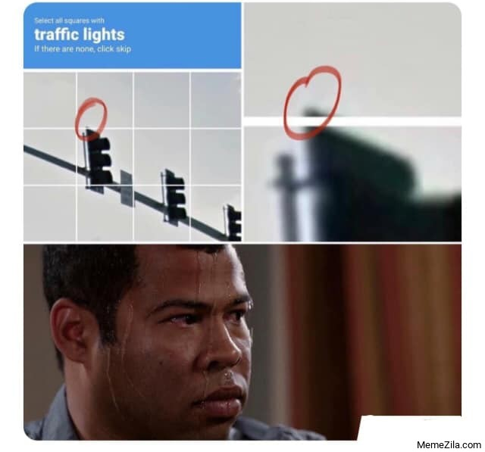
Why Can’t Machines Perceive Like Humans? (2 of 2)
Objects look different from different viewpoints
  Viewpoint invariance
Scenes contain high-level information
  Scenes are more complex

Slide 6
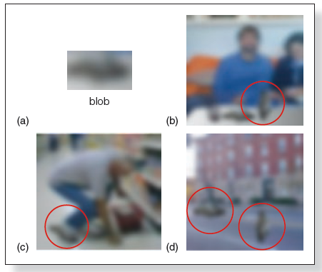
Notes:
(Source: Adapted from A. Oliva & A. Torralba, 2007)

Slide 7
Information Used in Human Perception
The human perceptual system uses two types of information:
  Environmental energy stimulating the receptors
  Knowledge and expectations the observer brings to the situation

Slide 8
Approaches to Understand Perception
Direct perception theories
  Bottom-up processing
  Perception comes from stimuli in the environment
  Parts are identified and put together, and then recognition occurs
Constructive perception theories
  Top-down processing
  People actively construct perceptions using information based on expectations

Slide 9
The Complexity of Perception (1 of 2)
Bottom-up processing
  Perception may start with the senses
  Incoming raw data
  Energy registering on receptors
Top-down processing
  Perception may start with the brain
  Person’s knowledge, experience, and expectations

Slide 10
Hearing Words in a Sentence (1 of 2)
  Top-down processing influences our perception of language based on our individual experience with the language
Speech segmentation
  The ability to tell when one word ends and another begins
Transitional probabilities
  Knowing which sound will likely follow another in a word
Notes:
Its not just visual perception that is tricky! Processing language is also tricky. We use “top-down” processing when perceiving language sounds. For example, How do we parse individual words when listening to someone speak?

Slide 11
Hearing Words in a Sentence (2 of 2)
  Top-down theory
  Some perceptions are the results of unconscious assumptions we make about the environment
  We use our knowledge to inform our perceptions
  We infer much of what we know about the world
  Likelihood principle
  We perceive the world in the way that is “most likely” based on our past experiences

Slide 12
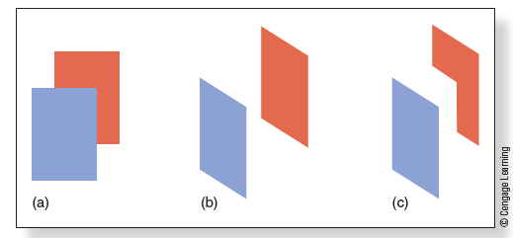
Unconscious Inference
Figure 3.14 The display in (a) is usually interpreted as being (b) a blue rectangle in front of a red rectangle. It could, however, be (c) a blue rectangle and an appropriately positioned six-sided red figure.

Slide 13
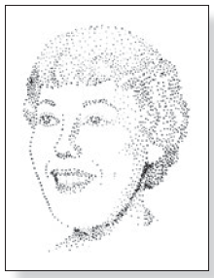
Perceptual Organization
  “Old” view—structuralism
  Perception involves adding up sensations
  “New” view—Gestalt principles
  The mind groups patterns according to intrinsic laws of perceptual organization
Notes:
Structuralism – adding up the dots makes the image
Gestalt view -- the image is due to us detecting patterns. In this case the dots!

Slide 14
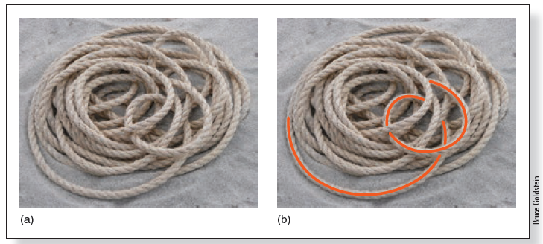
Gestalt Principles of Perceptual Organization (1 of 5)
  Principle of good continuation
  Lines tend to be seen as following the smoothest path
Figure 3.18 (a) Rope on the beach. (b) Good continuation helps us perceive the rope as a single strand.

Slide 15
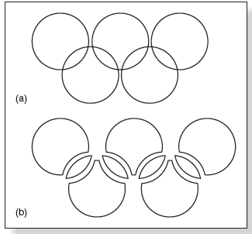
Gestalt Principles of Perceptual Organization (2 of 5)
  Law of pragnanz
  (Principle of simplicity or good figure)
  Every stimulus pattern is seen so the resulting structure is as simple as possible
Figure 3.19 The Olympic symbol is perceived as five circles (a), not as the nine shapes in (b).

Slide 16
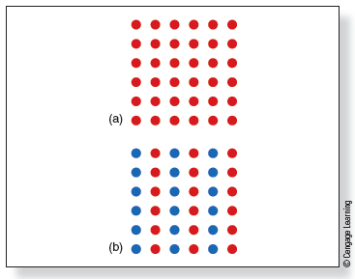
Gestalt Principles of Perceptual Organization (3 of 5)
  Principle of similarity
  Similar things appear grouped together
Figure 3.20 (a) This pattern of dots is perceived as horizontal rows, vertical columns, or both. (b) This pattern of dots is perceived as vertical columns.

Slide 17

Notes:
(Source: Courtesy of Wilma Hurskainen)

Slide 18
Gestalt Principles of Perceptual Organization (5 of 5)
  Perception is determined by specific organizing principles, not just dark and light stimuli activating the retina.
  Role of experience is minor compared to these intrinsic, “built in” principles.
  Experience can influence perception but is not the key driver.

Slide 19

Regularities of the Environment: Physical (1 of 3)
  Common physical properties of the environment
  Oblique effect
  We perceive verticals and horizontals more easily than other orientations

Slide 20
Regularities of the Environment: Physical (2 of 3)
  Light-from-above assumption
  We assume light comes from above because this
  is common in our environment
  We perceive shadows as specific information about depth and distance

Slide 21
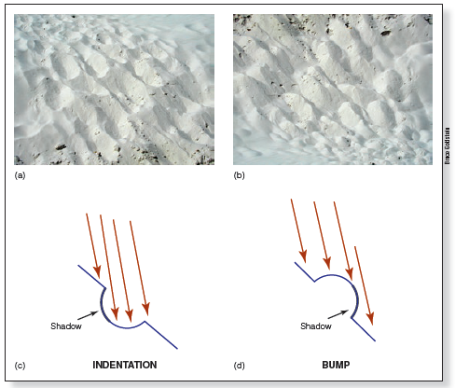
Regularities of the Environment: Physical (3 of 3)

Slide 22
Regularities of the Environment: Semantic
  The meaning of a given scene is related to what happens within that scene.
  Semantic regularities are the characteristics associated with functions carried out in different types of scenes.
  Scene schema:
  Knowledge of what a given scene ordinarily contains.
  In the jewelry case at Tiffany’s, would you expect to see a plate of fish and chips or diamond rings?

Slide 23
Comparing Conceptions of Object Perception
  Top-down processing
  Unconscious inference
  Environmental regularities
  Bayesian inference
  Bottom-up processing
  Gestalt principles

Slide 24
Neurons, Knowledge, and the Environment (1 of 2)
  Some neurons respond best to things that occur regularly in the environment.
  Neurons become tuned to respond best to what we commonly experience.
  Horizontals and verticals
  Experience-dependent plasticity

Slide 25
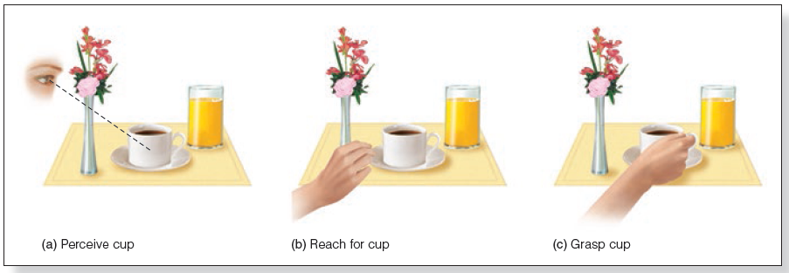
The Interaction of Perception and Action
  Constant coordination occurs in the brain as we perceive stimuli while also taking action toward them.

Slide 26
Perception and Action: What and Where (1 of 3)
  What pathway:
  Determining the identity of an object
  Ventral pathway (lower part of the brain)
  Where pathway:
  Determining the location of an object
  Dorsal pathway (upper part of the brain)

Slide 27
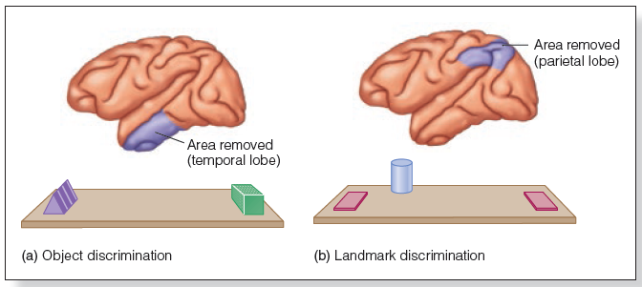
Perception and Action: What and Where (2 of 3)
Figure 3.30 The two types of discrimination tasks used by Ungerleider and Mishkin. (a) Object discrimination: Pick the correct shape. Lesioning the temporal lobe (purple-shaded area) makes this task difficult. (b) Landmark discrimination: Pick the object closer to the cylinder. Lesioning the parietal lobe makes this task difficult.
Notes:
(Source: Adapted from M. Mishkin et al., 1983)

Slide 28
Perception and Action: What and Where (3 of 3)
  Milner and Goodale (1995)
  Perception pathway:
  From visual cortex to temporal lobe
  Corresponds to the what pathway
  Action pathway:
  From visual cortex to parietal lobe
  Corresponds to the where pathway
  Also called the how pathway

